Slide 1
X-ray Basics: Module 3
Cardiac Anatomy in Fluoroscopy Views

Slide 2
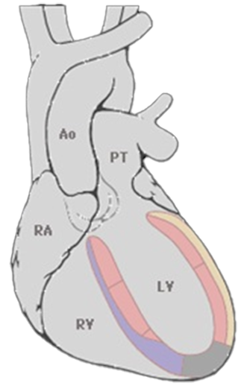
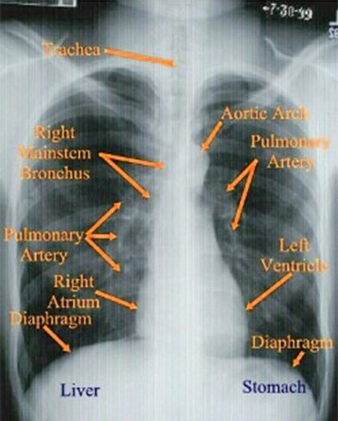
HEART ANATOMY IN X-RAY VIEWS
Chest X-ray – AP View

Slide 3
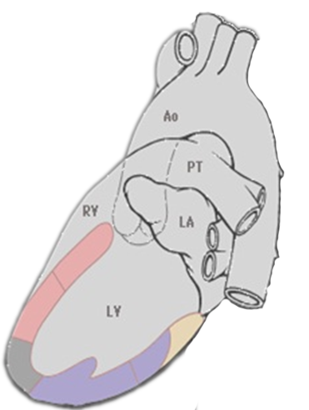
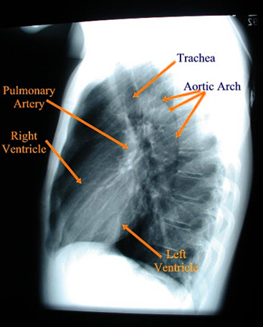
HEART ANATOMY IN X-RAY VIEWS
Chest X-ray – Lateral View

Slide 4
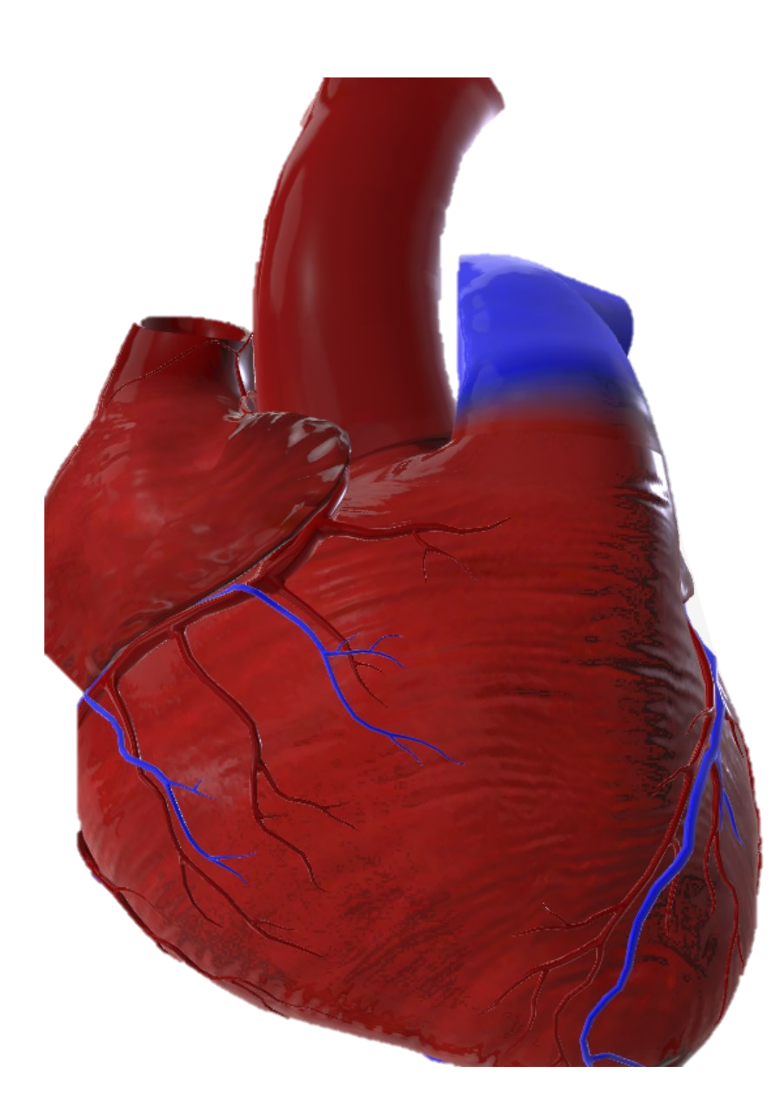
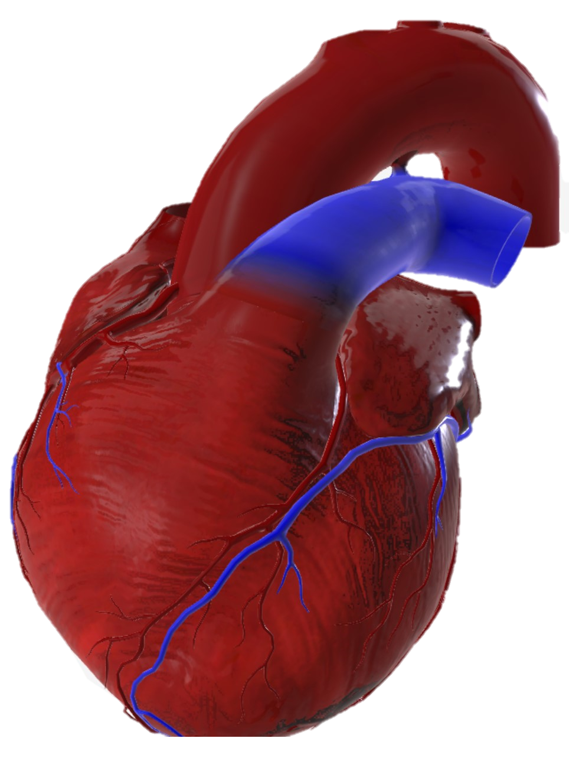
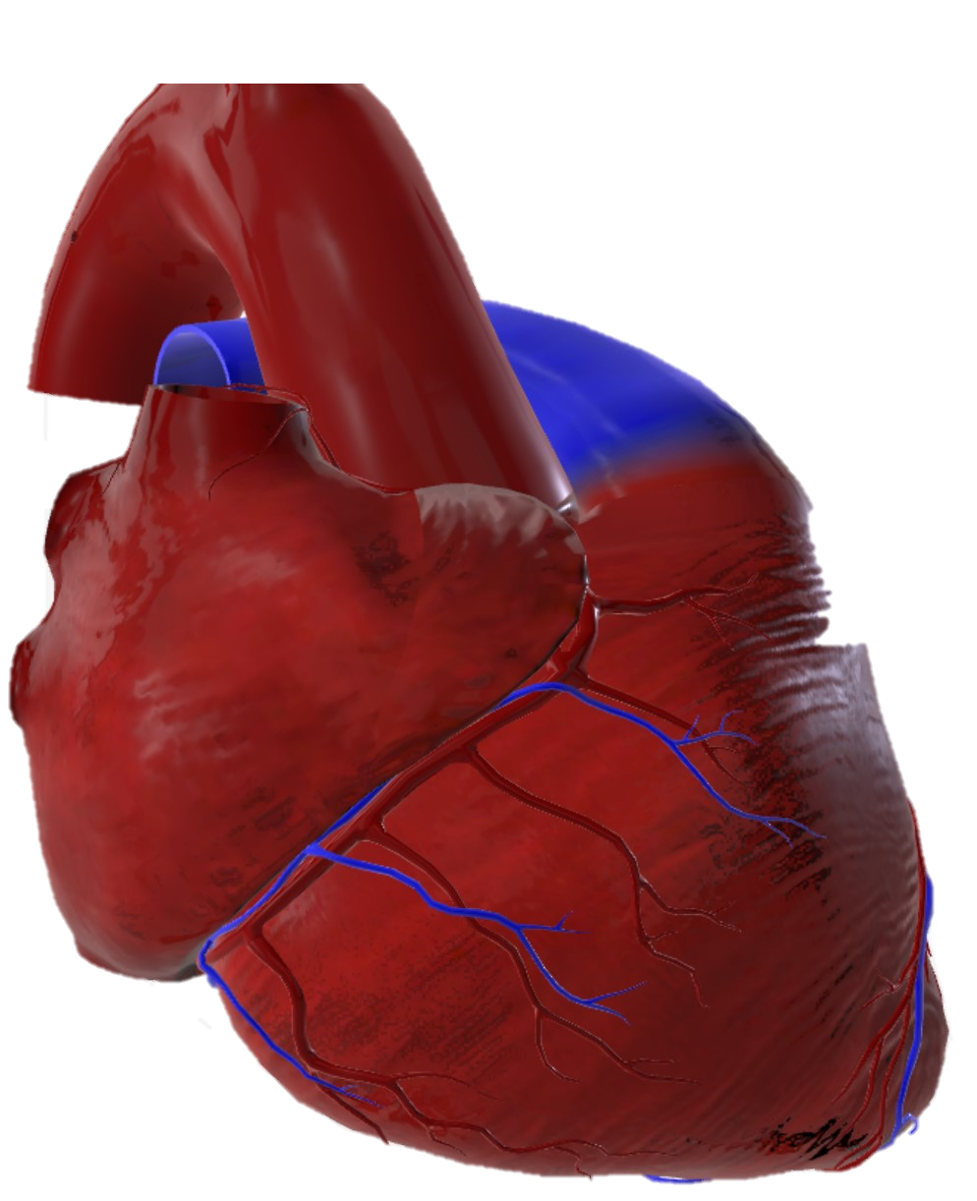
HEART ANATOMY IN FLUORO VIEWS

Slide 5
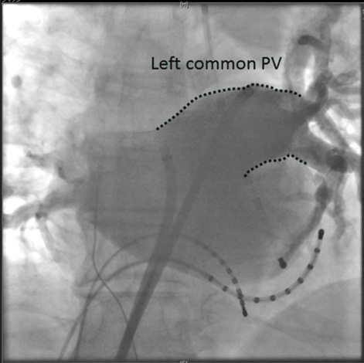
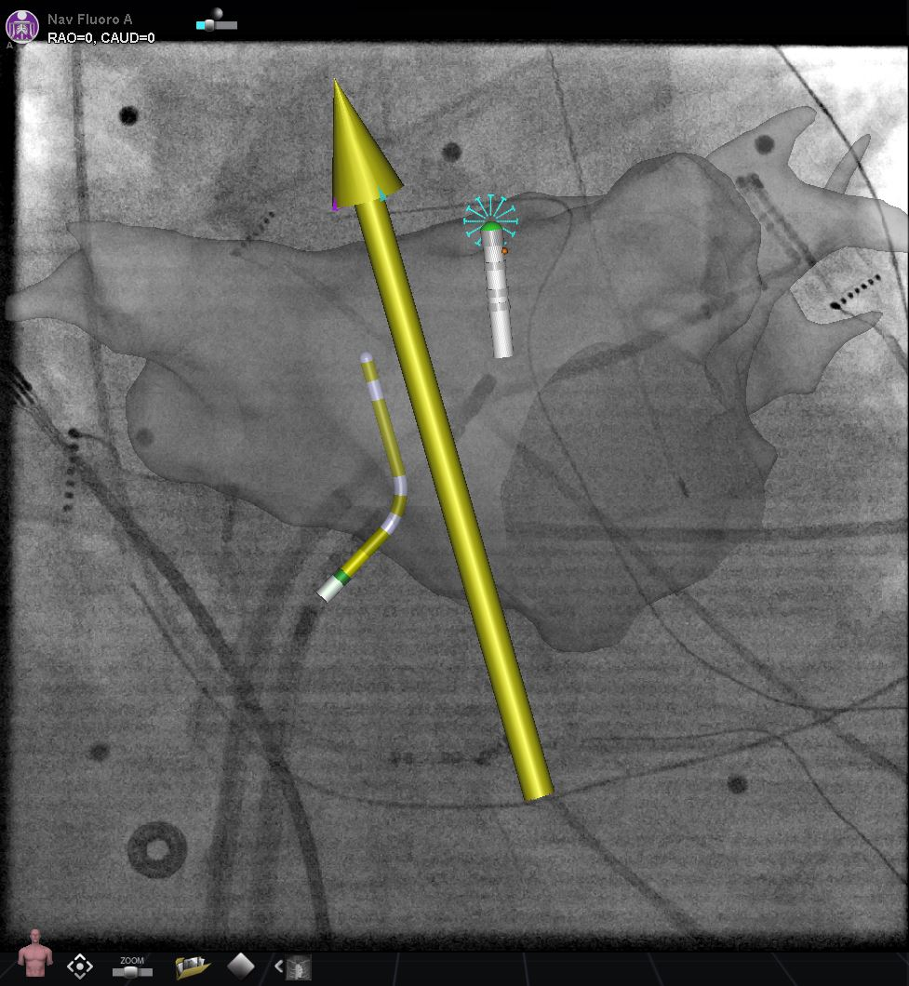
HEART ANATOMY IN FLUORO VIEWS
Fluoroscopy – AP View of the Left Atrium

Slide 6
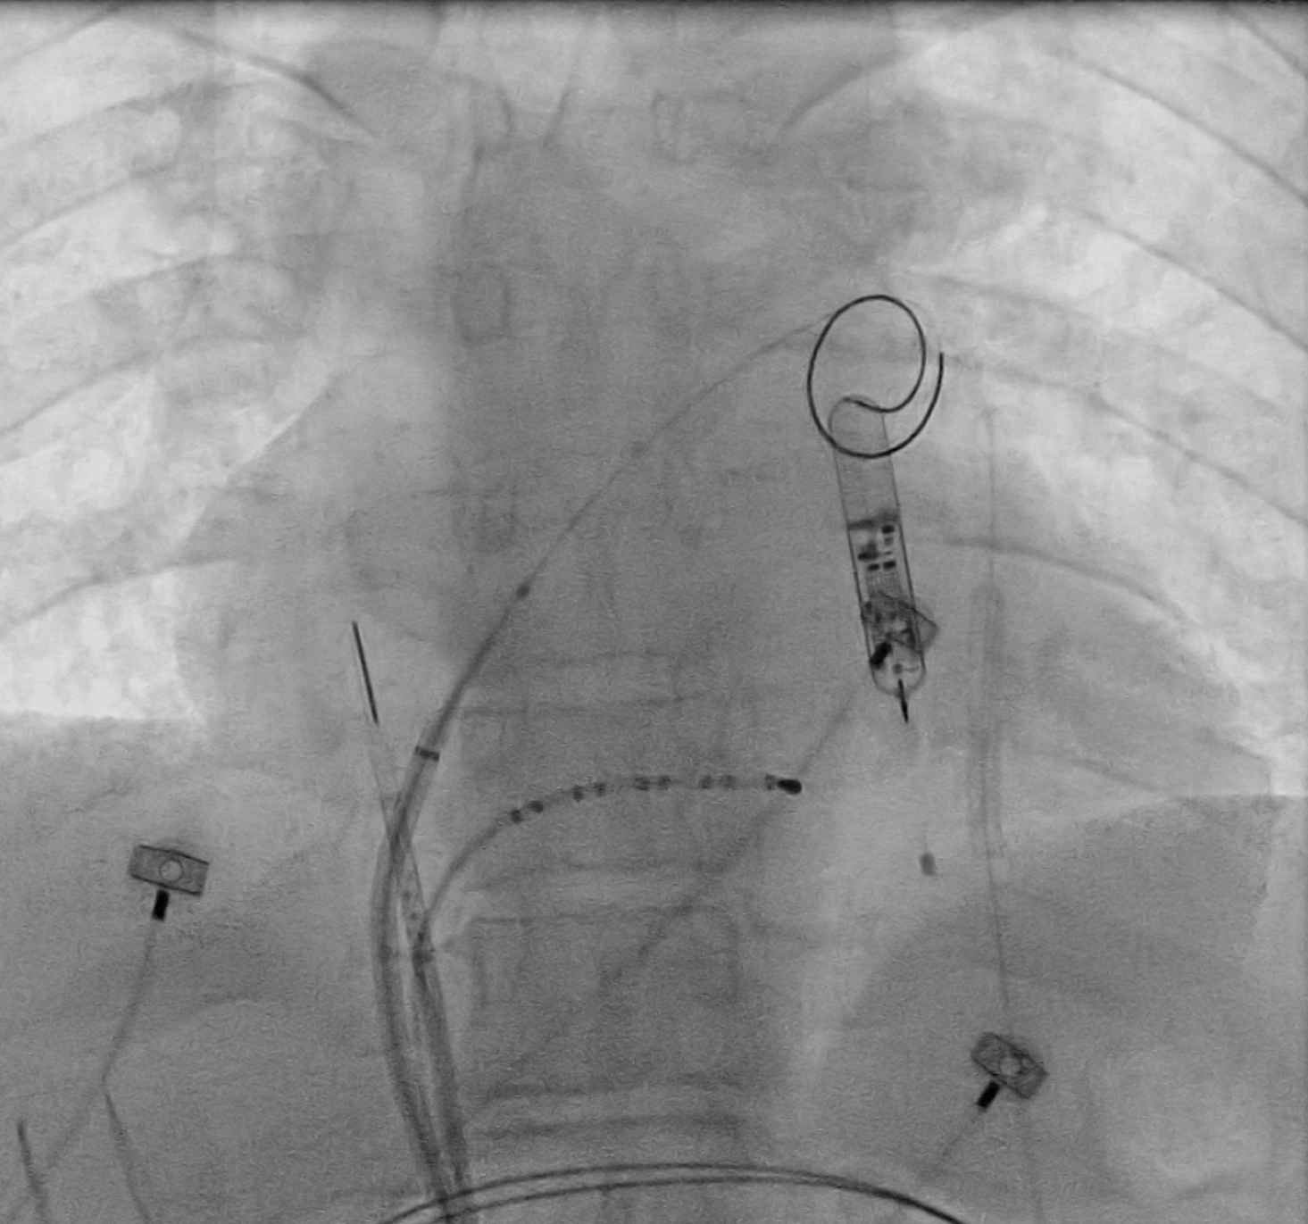
HEART ANATOMY IN FLUORO VIEWS
Fluoroscopy – AP View

Slide 7












HEART ANATOMY IN FLUORO VIEWS
Fluoroscopy – AP View
Heart Shadow
Spine
Diaphragm
Coronary Sinus with Catheter
Bronchial Tree
Transeptal Needle and Sheath

Slide 8
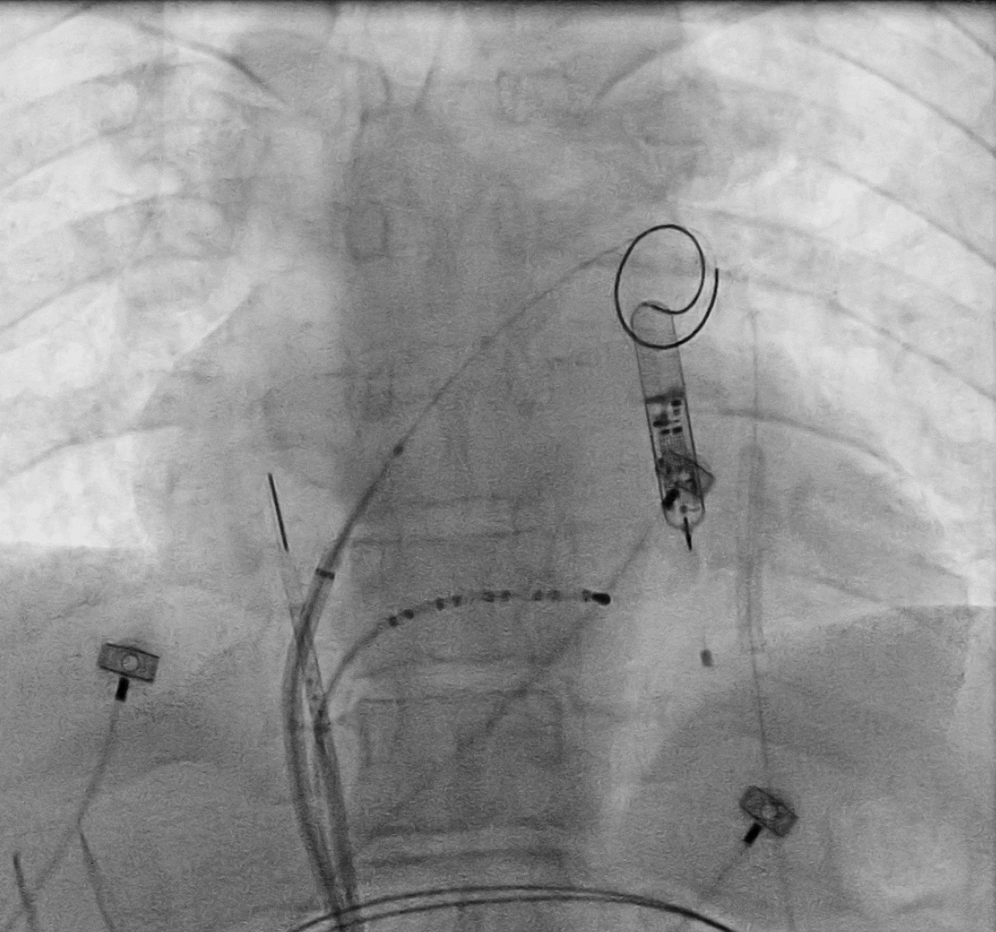
HEART ANATOMY IN FLUORO VIEWS
Fluoroscopy – AP View with Frontal Cut

Slide 9
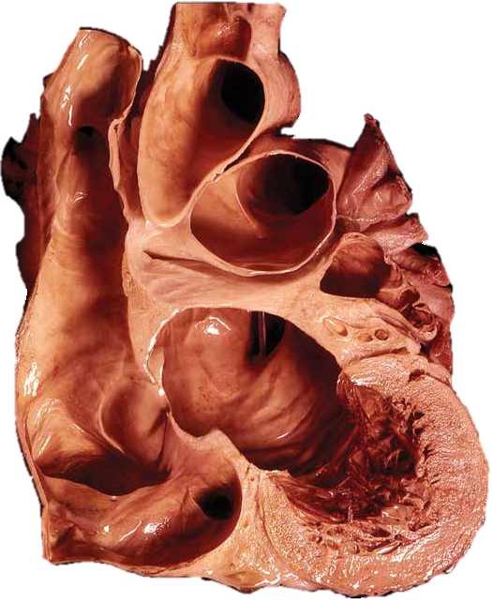

HEART ANATOMY IN FLUORO VIEWS
Aorta
Fluoroscopy – AP View with Frontal Cut
Pulmonary Artery
Superior Vena Cava
Left Pulmonary Veins
Right pulmonary veins
Left Atrial Appendage
Fossa Ovalis
Right Atrium
Left Atrium
Coronary Sinus Ostium
Left Ventricle

Slide 10
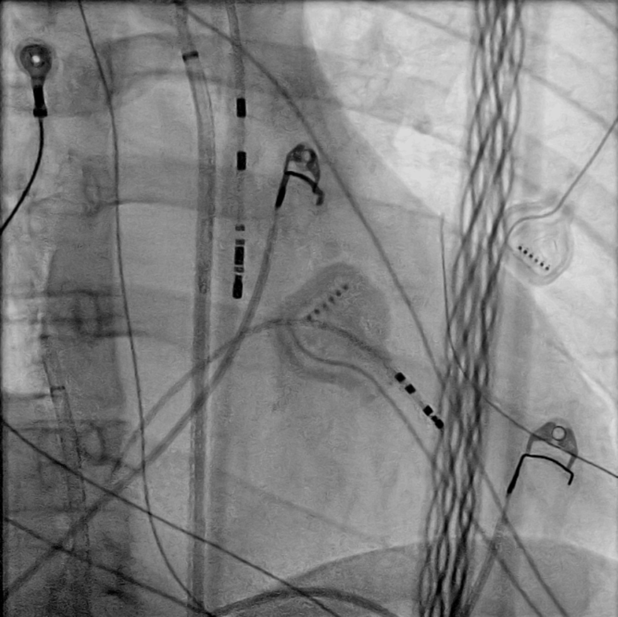
HEART ANATOMY IN FLUORO VIEWS
Fluoroscopy – RAO 30 View

Slide 11
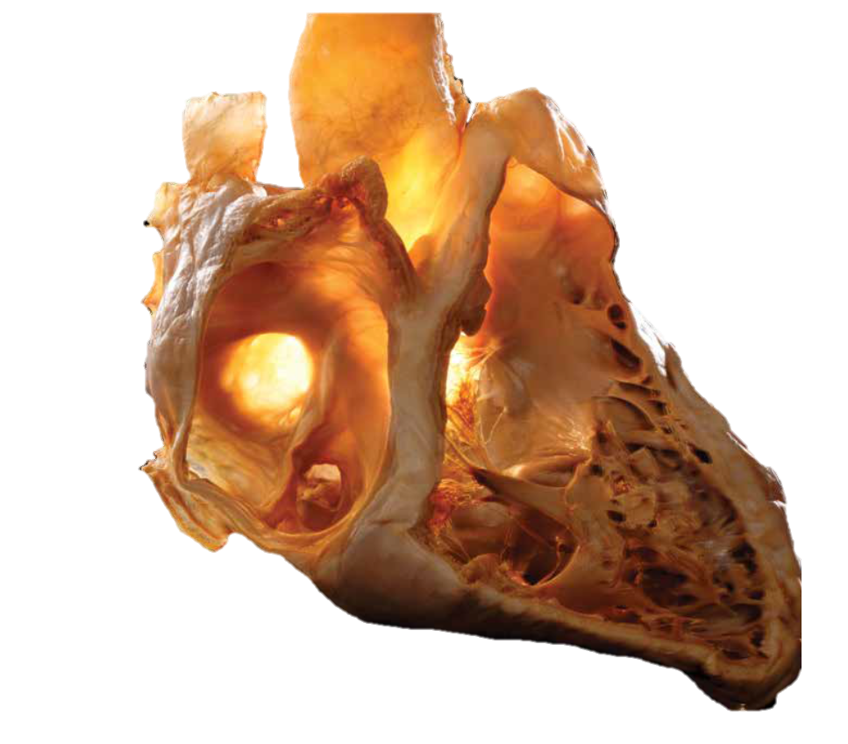
HEART ANATOMY IN FLUORO VIEWS
Fluoroscopy – RAO 30 View
Aortic arch
Superior Vena Cava
Right Atrial Appendage
Right Ventricle Outflow Tract (RVOT)
Right Atrium
Fossa Ovalis
Right Ventricle
Coronary Sinus Ostium

Slide 12
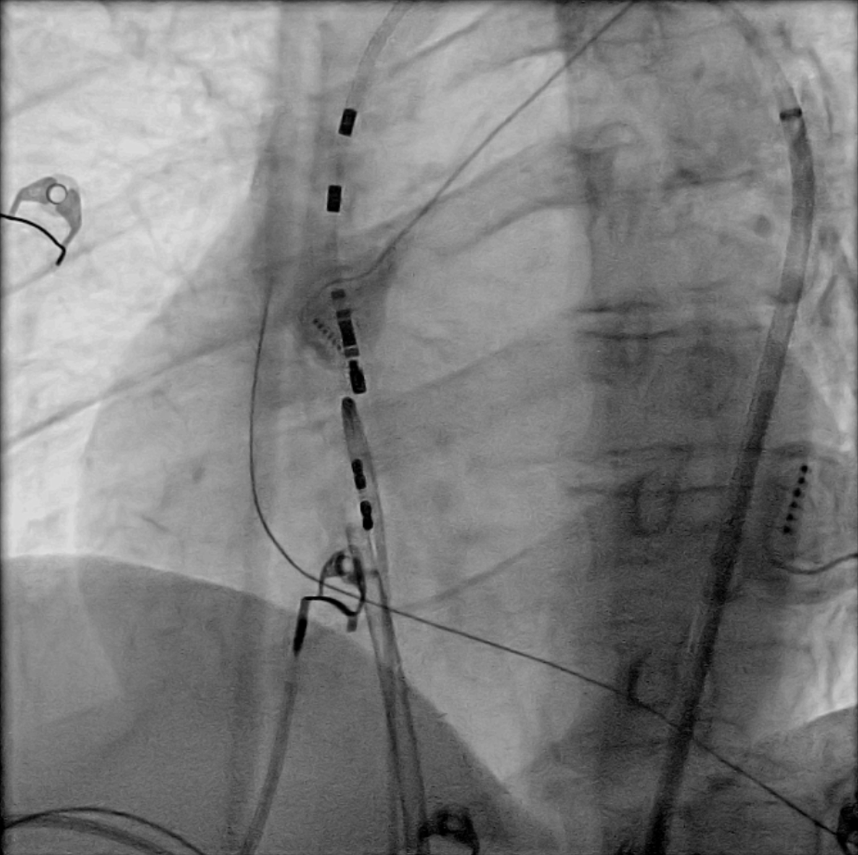
HEART ANATOMY IN FLUORO VIEWS
Fluoroscopy – LAO 30 View of Full Heart

Slide 13
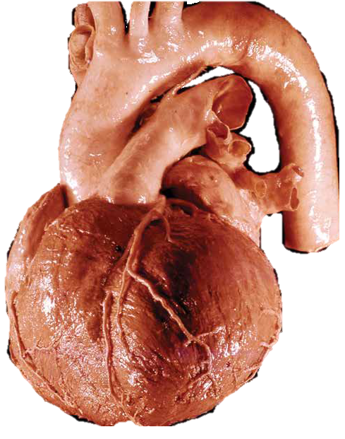
HEART ANATOMY IN FLUORO VIEWS
Fluoroscopy – LAO 30 View of Full Heart
Aortic Arch
Left Superior Pulmonary Vein
Ascending Aorta
Left Inferior Pulmonary Vein
Pulmonary Artery
Left Atrium
Right Atrium
Right Ventricle
Left Coronary Artery
Left Ventricle

Slide 14
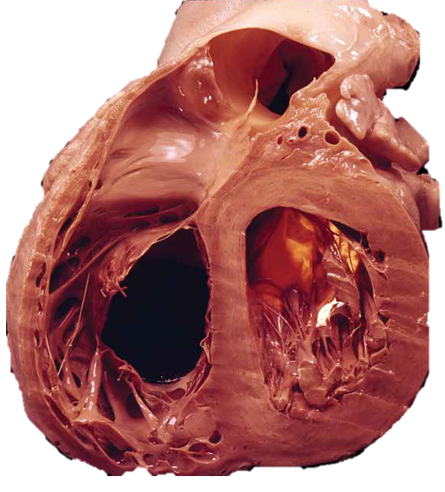
HEART ANATOMY IN FLUORO VIEWS
Right Ventricle Outflow Tract (RVOT)
Fluoroscopy – LAO 30 View Frontal Cut
Left Atrial Appendage
Left Coronary Artery
Interventricular Septum
Left Ventricle
Papillary muscle
Right Ventricle

