Slide 1
X-ray Basics: Module 1
How Fluoroscopy Systems Work

Slide 2
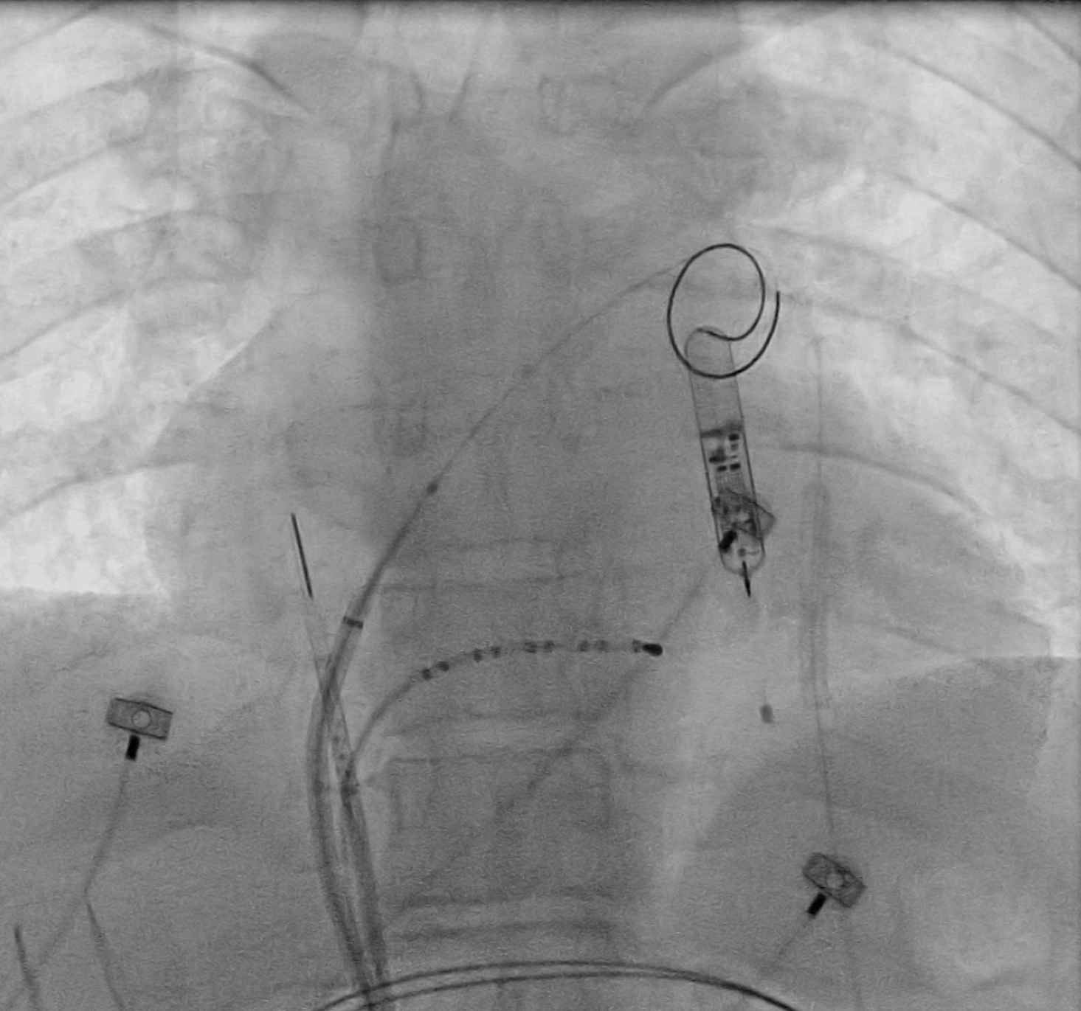
FLUOROSCOPY BASICS
Fluoroscopy
  Imaging technique commonly used by physicians to obtain real-time moving images of internal structures of a patient and operation of the tools through the use of fluoroscope.
    Fluoroscope consists of an x-ray source and detector between which a patient is placed.
X-rays are a form of ionizing radiation
  The potential procedure risks should be carefully balanced with the benefits to the patient. The typical procedure could result in a relatively high absorbed dose to the patient.
  Continuous exposure to scatter radiation is a health risk to the medical staff working in the lab.
  Recent advances of digitization of the captured images and flat-panel detector systems reduce the radiation

Slide 3
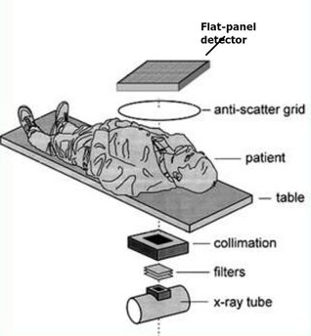
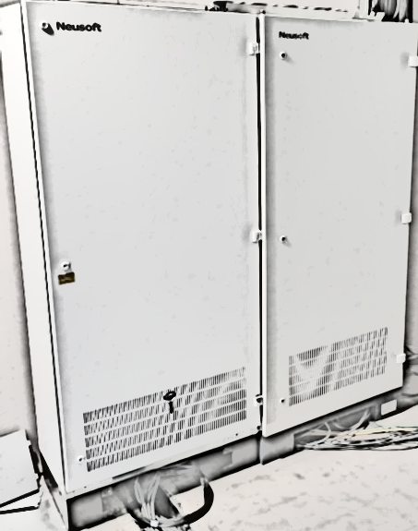
FLUOROSCOPY SYSTEM COMPONENTS
X-Ray Generator
X-Ray Tube
Collimator
Anti-Scatter Grid
Detector Plate
Image processor
Converts and enhances information from detector into an image that is displayed on the monitors
Monitor
High Power source
Filters
Source of x-ray Beam
Used to reduce the x-ray dose to patient
Contains various apertures that determine the size and shape of x-ray beam
Reduce the scattered x-rays reaching the detector
Captures the x-ray beams and converts them into a visible image
Displays the fluoro image for the clinician to use
MONITOR
IMAGE PROCESSOR
GENERATOR

Slide 4
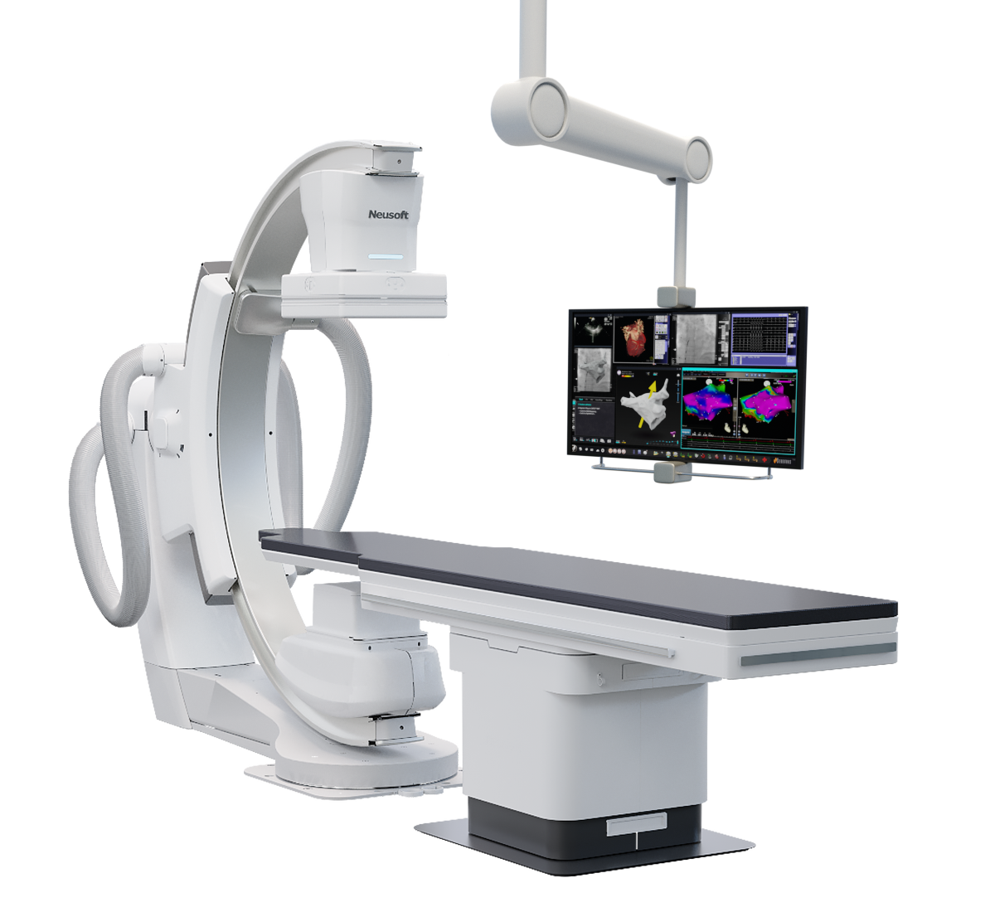
FLUOROSCOPY SYSTEM COMPONENTS
C-Arm
Flat Panel Detector
Monitor
Powered Table
X-Ray Tube
*Note: X-ray system shown here, not currently approved in US

Slide 5
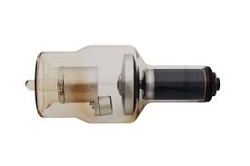
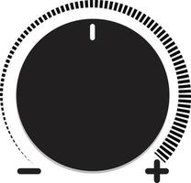
X-RAY TUBE, GENERATOR, COLLIMATOR
In an x-ray tube, free electrons are generated at the cathode by heating the cathode filament with a current (mA) provided by the x-ray generator.
The electrons are then accelerated across an electrical potential (kV).
X-rays are formed when the electrons rapidly decelerate as they collide with the anode.
X-rays are given off in all directions, but shielding absorbs all the photons except those that leave through the collimator.
Both cathode and anode are housed in a glass envelope usually made of Pyrex glass to resist heat, immersed in oil for cooling and electrical isolation.
Collimator
Anode
Cathode
+
-
Generator
kV
mA
kV = kiloVolt
mA = milliAmpere

Slide 6
X-RAY INTERACTIONS WITH TISSUE
To understand image generation, one must know how x-rays interact with tissues. X-rays entering the patient can do one of three things:
  No interaction: The x-ray passes through the tissue along a straight line into the detector (1). These are the x-rays that create the anatomic image.
    The differing degree to which tissues absorb x-rays generates light and dark features on the image
  Total absorption: X-ray energy of a photon is completely absorbed by the tissue, so it does not strike the detector (2)
    Unnecessary radiation. Does not contribute to image creation but affects patient´s body.
  Partial absorption and scatter: Some of the energy of the photon is absorbed and the photon, now of lower energy, is scattered.
    Scattering occurs in all directions
    Scattered photons may irradiate the operator or others in the room
      They may fall on the detector, resulting in degradation of the image by a background haze that does not contribute useful anatomic information (3)
      They may be absorbed by a subsequent interaction with patient tissues (4).
1
3
4
2

Slide 7
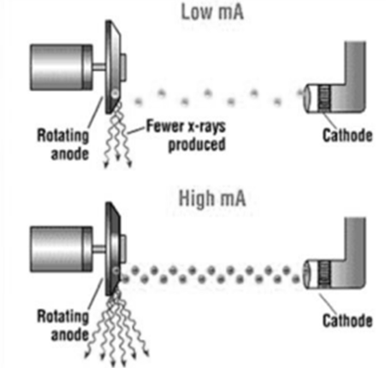
PARAMETERS INFLUENCING IMAGE GENERATION
Current
  The number of electrons at a given time (current) that are released from the cathode will directly influence the number of x-rays that are generated
  A low mA will result in fewer x-rays being produced and a high mA will result in a greater number of x-rays
  The greater the mA the more detailed the image and the higher the dose
Notes:
These diagrams demonstrate two operating conditions which influence the x-ray production process. The number of electrons that are released will directly influence the number of x-rays that are generated. While these diagrams show just a few electrons, the reality is there are billions of electrons that are released during any exposure. This diagram shows how a low mA will result in fewer x-rays being produced and a high mA will result in a greater number of x-rays. (The term mA is a unit of measure of electrical current)

Slide 8
PARAMETERS INFLUENCING IMAGE GENERATION
Potential
  The electrical potential between the cathode and the anode is measured in kV
  The kV value determines how hard the electrons from the cathode strike the anode (while mA is what determines how many electrons are available)
    Lower kV settings result in lower energy of the x-ray photons
    The higher the kV, the stronger the energy of the x-ray photons
  The fluoroscopy systems utilize algorithms to balance mA and kV to optimize the lowest fluoro dose needed to provide quality images

Slide 9
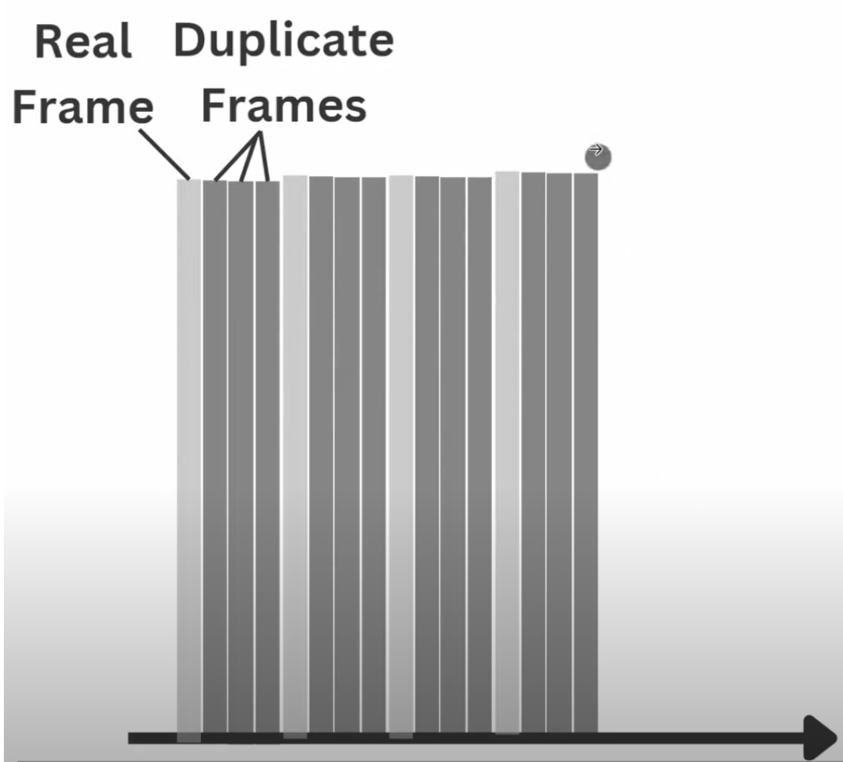
PARAMETERS INFLUENCING IMAGE GENERATION
Pulse Width and Rate
  Modern fluoroscopy systems works so that the electrical current to the x-ray tube is applied with on and off pulses
  When using pulsed fluoroscopy, the beam is off between pulses, but the image is displayed continuously and updated with each pulse
  Because the beam is mostly off, pulsed fluoroscopy is a means to reduce radiation to the patient
  The pulse width, measured in milliseconds (ms) is the time each pulse is on
    Short lengths can reduce motion blurring, but mA is usually increased so dose savings are small
    The fluoroscopy system usually automatically adjusts pulse width as part of the dose rate control algorithm
  The pulse rate, measured in pulses per second (p/s) can be selected
    Common rates are 3.75, 7.5, 15, and 30 pulses per second
    Selection of the best pulse rate depends on how quickly objects are moving
    The lower the rate the higher the dose saving

Slide 10
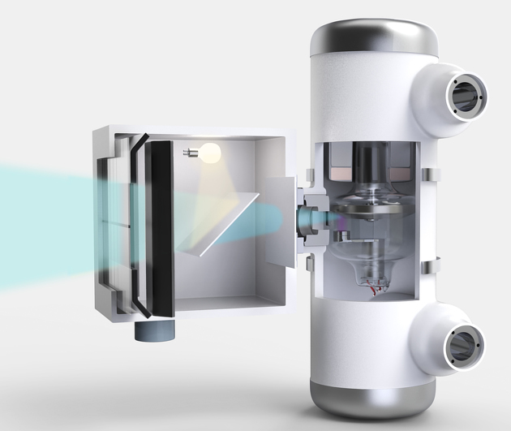
FILTERS
The x-ray beam consists of a spectrum of photon energies, the maximum of which is the kV (or peak kV = kVp). Low energy photons contribute nothing to the image because they are all absorbed by the first few centimeters of tissue, but they do contribute to skin injury. Low energy photons can be removed from the beam before they reach the patient by means of a thin metal foil, called a filter, placed at the exit port of the x-ray tube.
It is common for fluoroscopic imaging systems to be equipped with beam hardening filters between the X-ray tube exit port and the collimator. Added aluminum and/or copper filtration can reduce skin dose at the patient’s entrance surface.
Insertion of this added filtration in the beam path may be user-selectable, providing the operator with the flexibility to switch between low dose and higher dose modes as conditions dictate during a fluoroscopic procedure. Usually the added filtration is automatic, based on beam attenuation conditions, to achieve a desired level of image quality and dose savings.

Slide 11

COLLIMATION AND MAGNIFICATION
In fluoroscopy systems, magnification and collimation serve different purposes.
Magnification
  Most fluoroscopes offer several degrees of electronic magnification, expressed in field of view (FOV). A smaller field of view improves visualization of small structures at the expense of higher dose.
    Image Production: Magnification increases the size of the image by electronically zooming in on a smaller area of the field of view. This enhances the visibility of fine details.
    Dose Delivered: Magnification typically requires a higher radiation dose to maintain image quality, as the image intensifier or detector needs more X-rays to produce a clear image.
Collimation
  Collimation involves narrowing the X-ray beam to focus on a specific area, reducing the field of view.
    Image Production: This helps to minimize scatter radiation and improve image contrast.
    Dose Delivered: Collimation reduces the overall radiation dose to the patient by limiting the exposed area. However, the entrance skin dose may increase slightly because the X-ray beam is more concentrated.
FOV 30cm / 12”
FOV 20cm / 8”
FOV 15cm / 6”
Flat Detector
Flat Detector
Flat Detector
Collimator
Collimator
Fluoro Tube
Fluoro Tube
Fluoro Tube
Notes:
Collimation can be thought functioning like the iris of the eye.

Slide 12
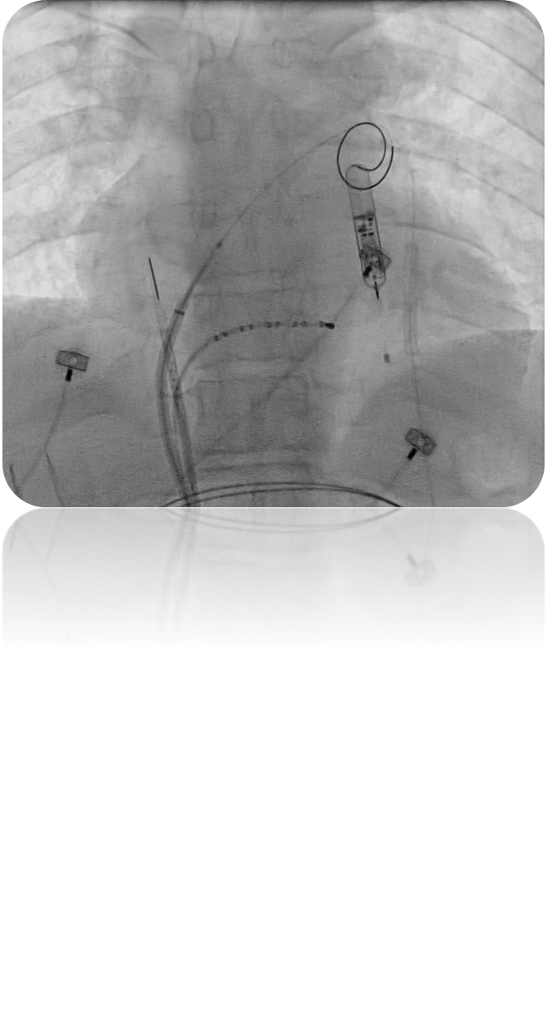
COLLIMATION AND MAGNIFICATION
FOV 30
FOV 20
FOV 15
FOV 30 with collimation
30cm / 12”
FOV 30 with collimation to focus on specific ROI
Flat Detector
Fluoro Tube

Slide 13
ANTI-SCATTER GRID
An anti-scatter grid intercepts the x-rays scattered by the patient that can cause clouding of the image, while allowing transmitted x-rays to pass through. Without a grid, much of the radiation reaching the detector is scattered x-rays.
A grid consists of numerous tiny thin plates of lead that are aligned toward the source. The grid is placed just before the detector. Only photons that are moving in a straight line from the source, i.e., not scattered, can pass between the lead plates and strike the detector.
Unfortunately, the grid also removes a significant fraction of the potentially useful unscattered x-rays that strike the lead plates edge-on. Use of a grid increases dose to the patient by a factor of 2 or more because the machine will need to compensate for the loss of transmitted x-rays. Therefore, grids should not be used when scatter is low, as in small children.
Flat Panel Detector
Anti-Scatter Grid

Slide 14
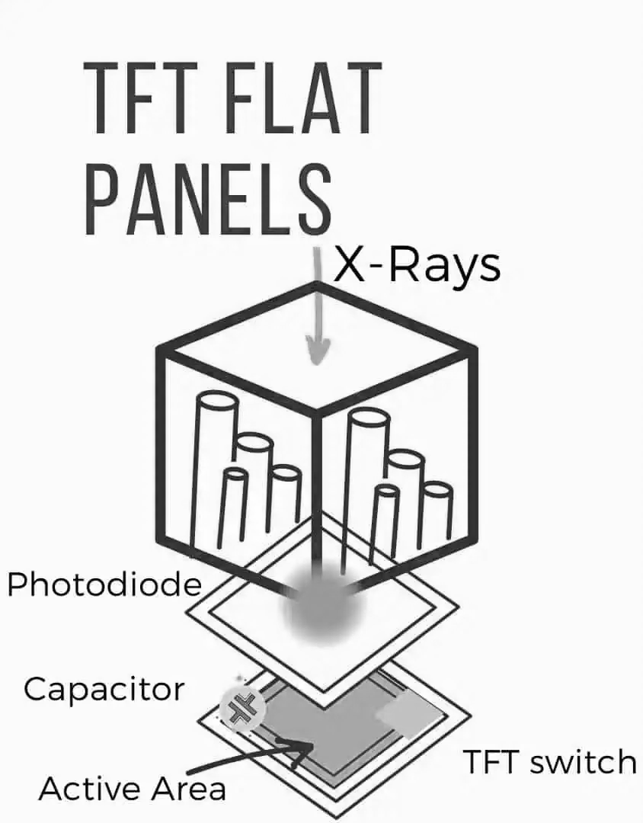
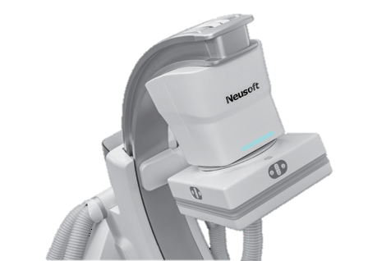
FLAT PANEL DETECTOR
A flat panel detector (FPD) in a fluoroscopy system is a crucial component that converts x-ray energy into digital images.
  X-ray Conversion: The FPD converts X-rays into electrical signals. This can be done either directly or indirectly. Indirect Conversion is more common to see in fluoroscopy systems.
    X-rays first hit a scintillator layer (e.g., cesium iodide CsI), which converts them into visible light. This light is then converted into electrical signals by a photodiode array. The photodiodes are typically made of amorphous silicon (aSi).
    Some flat panel detector use Complementary Metal-Oxide-Semiconductor (CMOS) to convert light back into electrical signal in a faster and more effective way.
  Signal Processing: The electrical signals are read out by the thin film transistor (TFT) array and sent to a computer for processing
Flat Panel Detector
*Note: X-ray system shown here, not currently approved in US

Slide 15

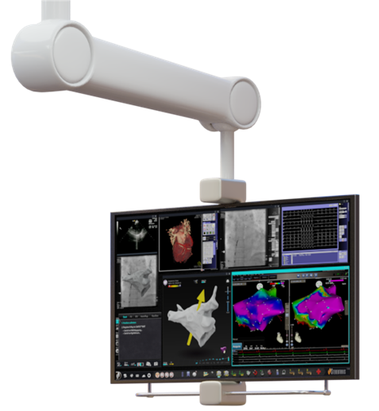

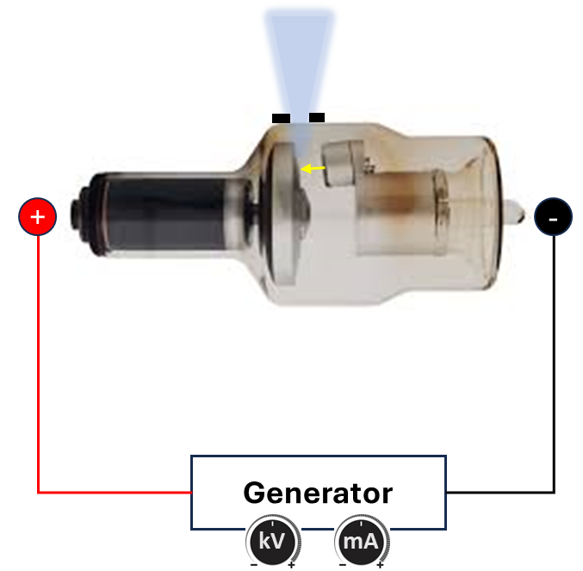

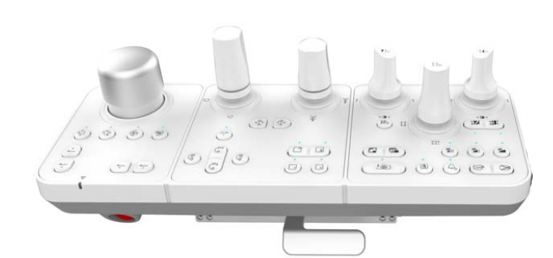
IMAGE PROCESSOR
Modern Image processor and Control Software adjust multiple aspects of the process that will result in the final image on the monitor screen
  Imaging parameters for real-time images
  Image adjustment of acquired images
  Advanced imaging tools for specific clinical applications
  System tools
Most of the adjustments are made automatically but operator can make desired changes as needed
Pre-Procedure
Patient information (age, weight, height, imaging target)
Physician Preferences (frame rate, dose/image quality..)
Detector
Image Processor
Real-Time Imaging
AEC Automatic Exposure Control (Imaging parameters (kV, mA, pW, Filter, Focal spot))
Motion artefact reduction
Digital image enhancements (i.e. edge enhancement)
Advanced clinical tools (i.e. masks)
Post-Processing
Digital image enhancements
Measurements and Analyses

Slide 16
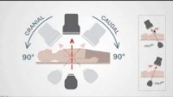
FLUOROSCOPY SYSTEM OPERATION
Projections of the C-arm to obtain different views of the target anatomy

Slide 17
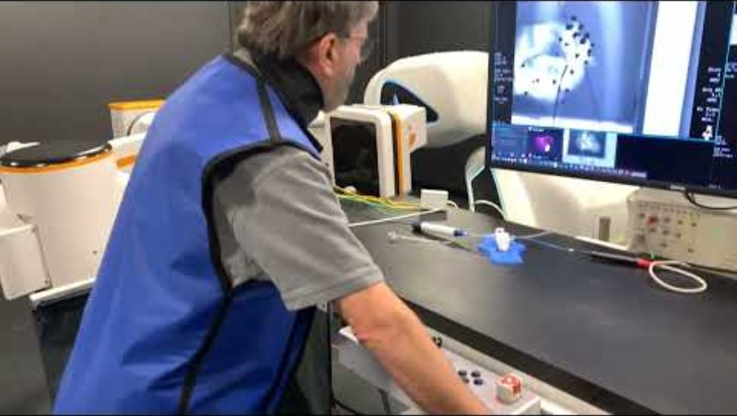
FLUOROSCOPY SYSTEM OPERATION
Isocentering: centering the region of interest (ROI)

