Slide 1
X-ray Basics: Module 2
Radiation Safety and Dose Control

Slide 2
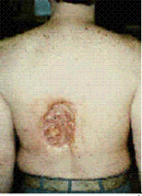
FLUOROSCOPY EXPOSURE RISKS
All fluoroscopic procedures pose a potential health risk to the patient.
Radiation dose to the patient depends greatly on the size of the patient as well as length of the procedure.
All fluoroscopy-guided procedures present the risk of cancer-inducing ionizing radiation effects.
  Additionally, longer interventional procedures can also produce radiation effects ranging from mild erythema (redness of the skin), equivalent of a sun burn, to more serious burns.
The physician and laboratory personnel are at greater risk due to the accumulative effects of repeated exposure.

Slide 3
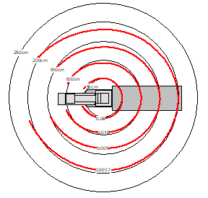
RADIATION EXPOSURE
Measurement of Radiation Exposure
  The closer you are to the central beam, the higher the dose
  Measurement of radiation exposure on staff
    1milligray (mGy) = 100 mrads (mR)
    Badges will measure in mRem
      1rad = 1rem
  Kerma Maps are provided with the X-ray system which:
    Show maps of X-ray scatter at certain isocentered positions
    Are required to understand the effect of X-ray and dosage reduction
Example above is a scatter map provided by X-ray manufacturer. Dose shown in uGy*m2, which represents a scatter dose per dose area product. Actual numbers can vary based on settings of the system.

Slide 4
RADIATION EXPOSURE
The fluoroscope will display the cumulative “air kerma” during the procedure, expressed in units of gray (or milligray).
Air kerma is a rough estimate of total skin dose at the beam entry site, but it assumes the fluoroscope was stationary and directed at one skin field during the entire procedure. It will overestimate the peak skin dose if the dose was distributed over multiple skin sites. It may underestimate peak skin dose if the patient was close to the x-ray tube, as for example if the patient was obese, or if the patient was improperly positioned.
The kerma (Dose) Area Product (DAP) is a good measure of the total amount of radiation energy delivered to the patient. Try to minimize this number when performing procedures, even for those procedures that are well below the skin injury range.

Slide 5
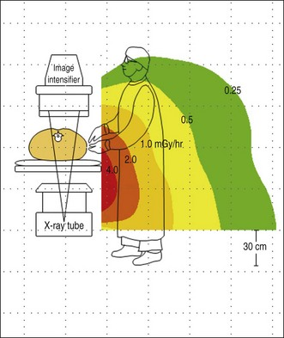
RADIATION REDUCTION
Scatter Radiation: photon particles which hit physical barriers on or around the area of interest (i.e., bed, robotic system) and are scattered away from the detector plate.
Many Ways to reduce radiation exposure with technology and best practices
  Lead shields, personal protection, and lead table skirts are the most basic ways to reduce exposure
  Technology development
    Better image at lower dosages
    Tools to reduce use of x-ray
  Collimator and shutter
    Physical blades which reduce the primary beam of photon particles
      Can limit a patient’s exposure to scatter radiation
  Variable SID (Source Image Distance)
    Being able to lower the detector plate closer to the area of interest can reduce the amount of photon particles that scatter
      Will affect image magnification
Detector
↓
Direction of X-Ray
More information
https://www.ncbi.nlm.nih.gov/pmc/articles/PMC9527100/

