Slide 1
INSTRUCTIONS
Find the template that best suits how many images you have.
There are 5 PVC/VT templates:
  PVC, Fluoro, Map
  PVC, Fluoro, Map, Additional Image
  PVC, 2 Fluoro images, 2 additional images
  2 PVC morphologies, 2 fluoro images, Map
  VT morphology, Pre-op imaging, Fluoro, Map
1 template for AF
1 template for all other procedure types
Please delete all slides that are not used when submitting your case submission.
Details matter!

Slide 2
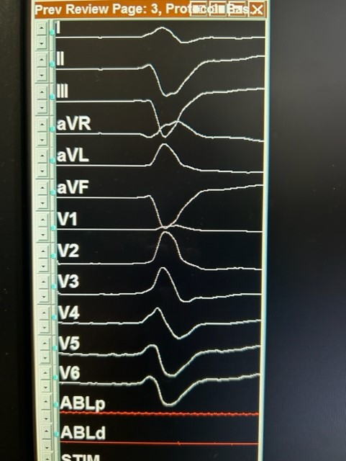
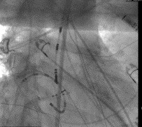

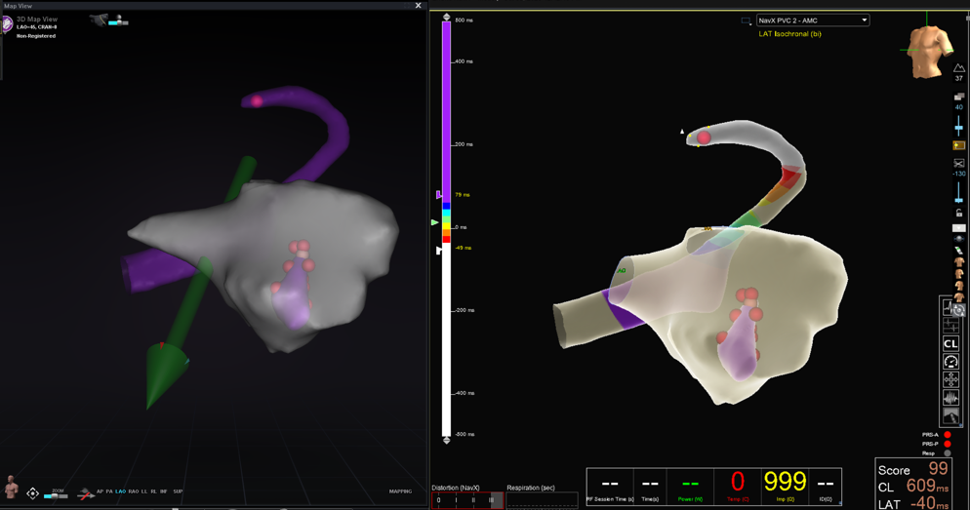

(PVC/VT Template – 1) Physician, Hospital, Procedure Type
Where is the PVC coming from and why?
PMP
Superior Axis
RBBB
+ Lead 1
+ aVL
Reverse transition
Procedure Info:
Patient Background
Age:
Sex:
Other factors:
Type of VT:
Access:
Catheters used:
Sheath used:
Procedure Workflow:
Learning Opportunities:
What went well, what didn’t, how did you overcome obstacles, did physician need coaching, physician feedback if any, what did you learn, how did robotics add value?
Description of sheath placement:
Description of Final Images:
Power: 50W
Duration: 60-120 second lesions
Endpoint:

Slide 3
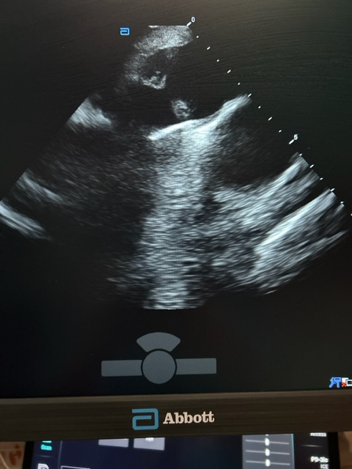
(PVC/VT Template – 2) Physician, Hospital, Procedure Type
Where is the PVC coming from and why?
PMP
Superior Axis
RBBB
+ Lead 1
+ aVL
Reverse transition
Procedure Info:
Patient Background
Age:
Sex:
Other factors:
Type of VT:
Access:
Catheters used:
Sheath used:
Procedure Workflow:
Learning Opportunities:
What went well, what didn’t, how did you overcome obstacles, did physician need coaching, physician feedback if any, what did you learn?
Description of sheath placement:
Description of ICE:
Description of Final Images:
Power: 50W
Duration: 60-120 second lesions
Endpoint:

Slide 4
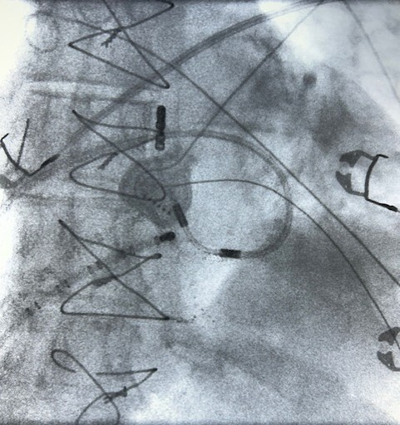
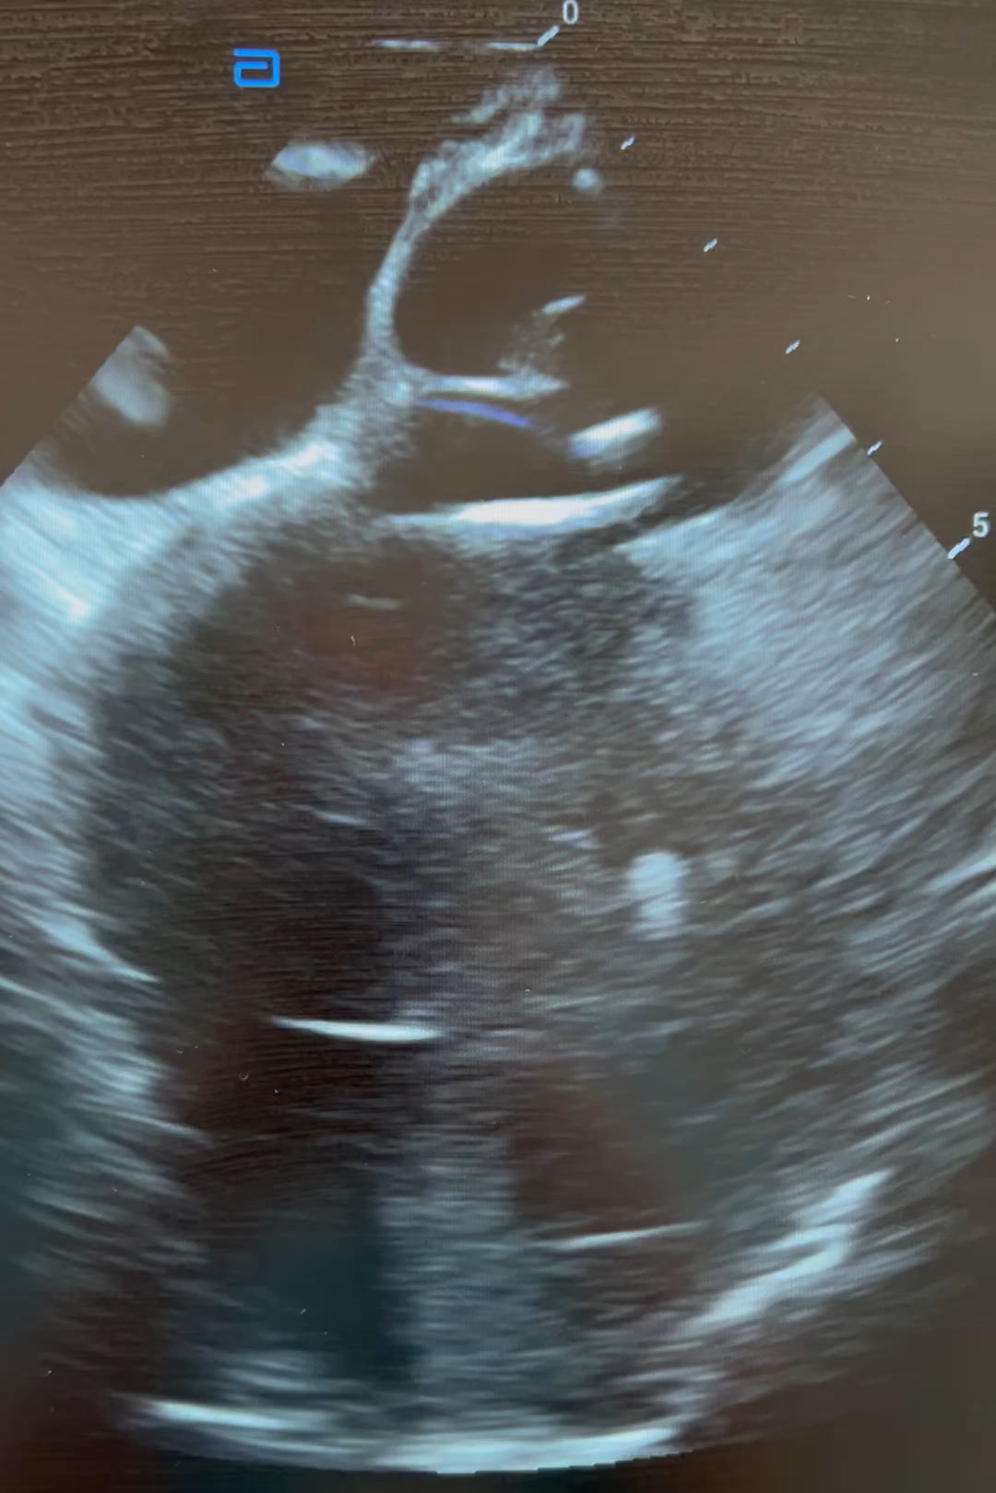
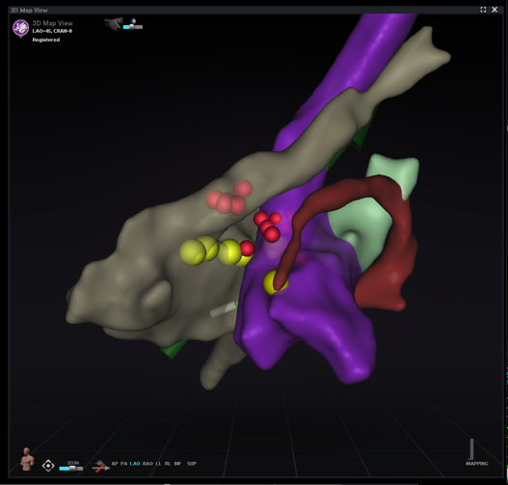
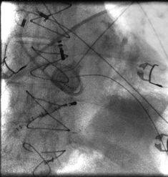
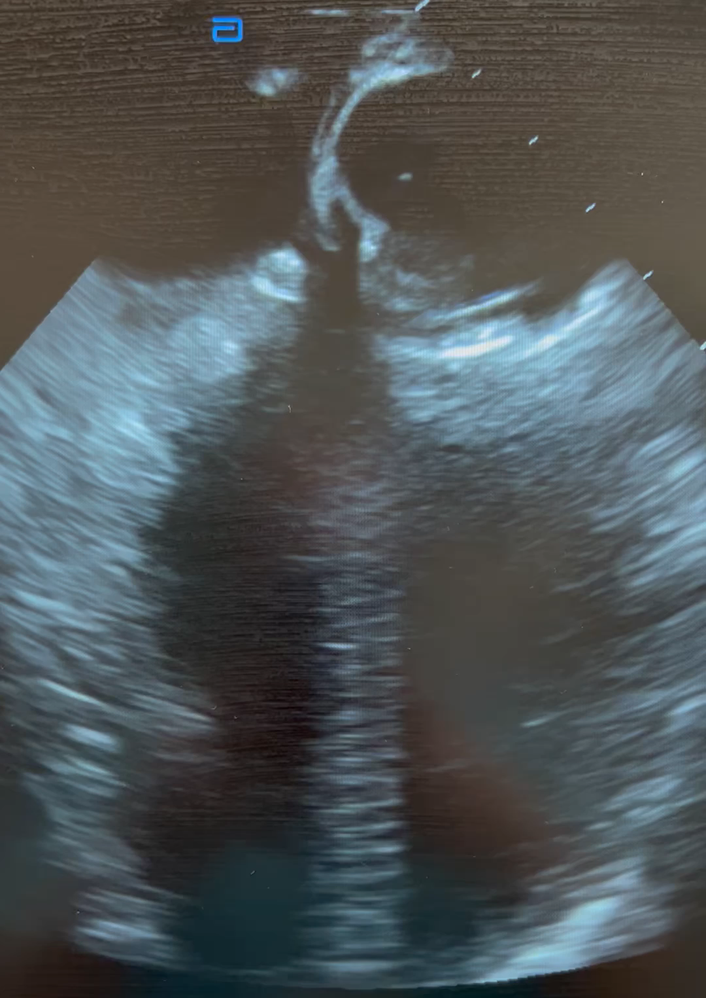
(PVC/VT Template – 3) Physician, Hospital, Procedure Type
Where is the PVC coming from and why?
PMP
Superior Axis
RBBB
+ Lead 1
+ aVL
Reverse transition
Procedure Info:
Patient Background
Age:
Sex:
Other factors:
Type of VT:
Access:
Catheters used:
Sheath used:
Procedure Workflow:
Learning Opportunities:
What went well, what didn’t, how did you overcome obstacles, did physician need coaching, physician feedback if any, what did you learn?
Description of sheath placement:
Description of Additional Image
Description of Final Images:
Power: 50W
Duration: 60-120 second lesions
Endpoint:
Description of sheath placement:
Description of Additional Image:

Slide 5
(PVC/VT Template – 4) Physician, Hospital, Procedure Type
Where is the PVC coming from and why?
PMP
Superior Axis
RBBB
+ Lead 1
+ aVL
Reverse transition
Procedure Info:
Patient Background
Age:
Sex:
Other factors:
Type of VT:
Access:
Catheters used:
Sheath used:
Procedure Workflow:
Learning Opportunities:
What went well, what didn’t, how did you overcome obstacles, did physician need coaching, physician feedback if any, what did you learn?
Description of sheath placement:
Description of Final Images:
Power: 50W
Duration: 60-120 second lesions
Endpoint:
Where is the PVC coming from and why?
PMP
Superior Axis
RBBB
+ Lead 1
+ aVL
Reverse transition
Description of sheath placement:

Slide 6
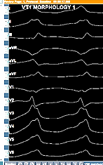
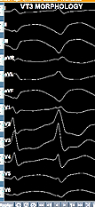
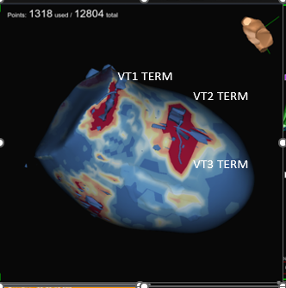
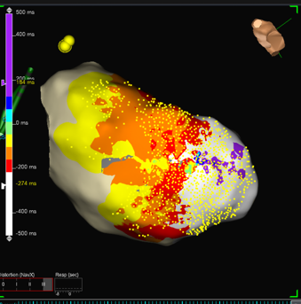
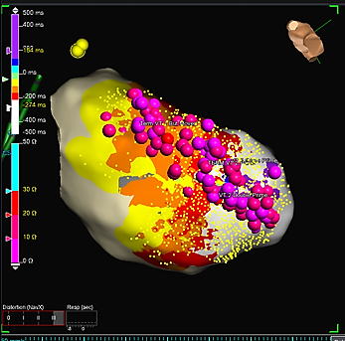
(PVC/VT Template – 5) Physician, Hospital, Procedure Type
Procedure Info:
Where is the VT coming from? RV or LV?
VT1:
VT2:
Patient Background
Age:
Sex:
Other factors:
Type of VT:
Access:
Catheters used:
Sheath used:
Procedure Workflow:
Learning Opportunities:
What went well, what didn’t, how did you overcome obstacles, did physician need coaching, physician feedback if any, what did you learn?
Pro-Op Imaging:
Description of sheath placement:
Description of Final Images:
Power: 50W
Duration: 60-120 second lesions
Endpoint:

Slide 7
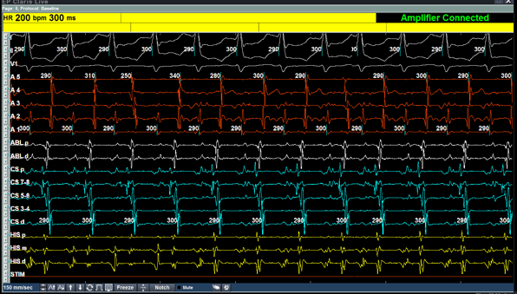
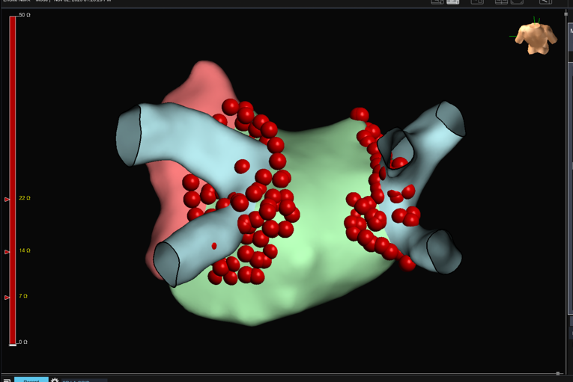
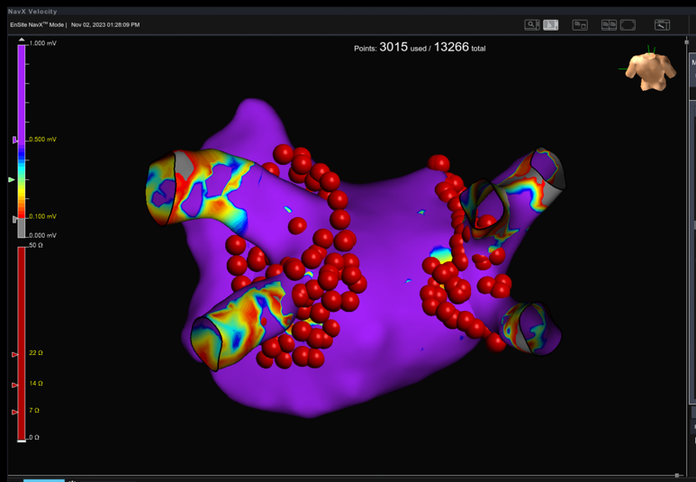
(AF Template) Physician, Hospital, Type of AF
Procedure Info:
Patient Background
Age:
Sex:
Other factors:
Type of AF:
Access:
Catheters used:
Sheath used:
Procedure Workflow:
TSP placement:
Learning Opportunities:
What went well, what didn’t, how did you overcome obstacles, did physician need coaching, physician feedback if any, what did you learn?
EP Tracing: (Describe what the tracing is telling us?)
Patient is in AF
You can tell this by looking at
Description of sheath placement:
Left sided veins placement
Description of sheath placement:
Right sided veins placement
OR ICE pic of TSP
Description of Final Images:
Power Post Wall: 50W
Power Ant Wall:
Duration: 60-120 second lesions
Carina line: Yes or no?
Additional Ablation:
Time to isolation:

Slide 8
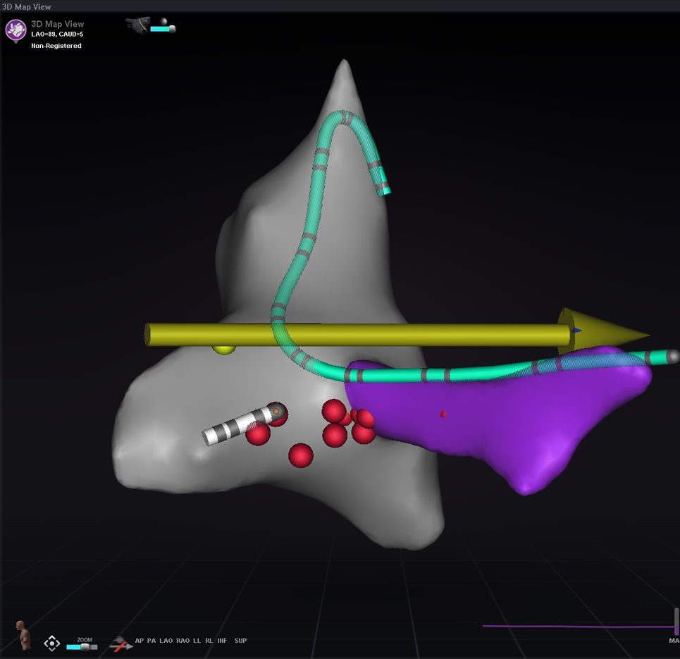
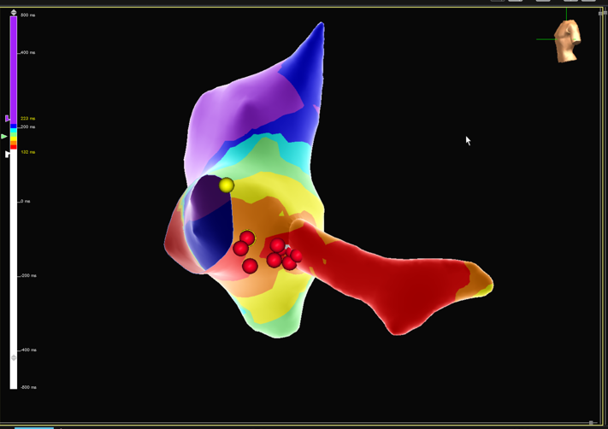
(AVNRT/AT/AFL/AVRT Template) Physician, Hospital, Procedure Type
Procedure Info:
Patient Background
Age:
Sex:
Other factors:
Access:
Catheters used:
Sheath used:
Procedure Workflow:
Learning Opportunities:
What went well, what didn’t, how did you overcome obstacles, did physician need coaching, physician feedback if any, what did you learn?
EP Tracing: (Describe what the tracing is telling us?)
Picture of tachycardia
Description of sheath placement:
Additional Photo/Video if applicable
Description of Final Images:
Power: 50W
Duration: 60-120 second lesions
Endpoint:

